Slide 1

Software Code Bug Detection & Fixing
Intel Unnati Industrial Training Program 2025 Presented by – Team NeuralFixers

Slide 2
Content
Objective
Project Overview
Approach
Architecture Diagram
Evaluation Metrics & Test Results
Deployment and UI
Limitations
Future Work
Conclusion

Slide 3
Team Members & Their Contributions
Shreyansh Yadav
Designed and implemented the Data Preprocessing Pipeline
Developed the Bug Detection Module using CodeBERT & DeepSeek-Coder
Implemented Automatic Bug Fixing using DeepSeek-Coder
Handled Model Evaluation and metric analysis
Abantika Addya
Implemented Automatic Bug Fixing using DeepSeek-Coder
Developed the User Interface & Deployment Pipeline using Gradio
Handled Model Evaluation and metric analysis
Prepared Project Documentation and the Final Presentation

Slide 4
Objective
To automate the detection and fixing of software bugs in Python code using pretrained transformer-based models.
Reduce manual debugging efforts by providing AI-powered suggestions and corrections.
Build an end-to-end pipeline for integrating bug detection and fixing into real-world development workflows.

Slide 5
Project Overview
Developed using pretrained models like CodeBERT and DeepSeek-Coder.
Works on Python code snippets with known bugs and fixes.
No fine-tuning required — models used directly in inference mode.
Includes a data pipeline, bug detection, automatic fixing, and a simple UI.
Enables real-time debugging support for developers.

Slide 6
Approach
Preprocessing- Clean and normalize Python code samples
Feature Extraction- Use AST (Abstract Syntax Tree) and tokenization.
Bug Detection- Identify bugs using CodeBERT and DeepSeek-Coder
Bug Fixing- Generate fixed code using DeepSeek-Coder-1.3B-Instruct.
Pipeline Execution- Efficient batch processing with PyTorch.

Slide 7
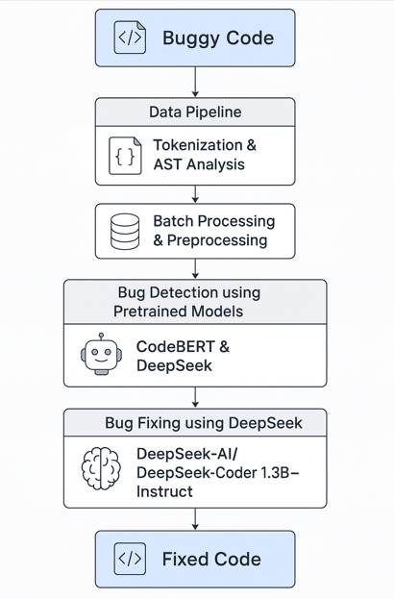
Architecture Diagram

Slide 8
Evaluation Metrics & Test Results
Metric | CodeBERT | DeepSeek
Accuracy | 91.3% | 93.6%
Precision | 89.7% | 92.1%
Recall | 90.2% | 93.0%
F1-Score | 89.9% | 92.5%
BLEU Score | 84.5 | 88.3

Slide 9
Deployment and UI
Deployment Overview:
Utilized Google Colab for development and testing.
Scripts automate:
Model loading (CodeBERT & DeepSeek)
Bug detection and fixing pipeline
Web Interface (Gradio):
Simple UI for user interaction.
Features:
Input Python code
Detected errors and receive auto-corrected code

Slide 10
Limitations
Model Dependence: Relies on pretrained models — performance is limited to the capabilities of those models.
Language Restriction: Currently supports only Python.
No Fine-tuning: Models are not fine-tuned on the dataset — may miss context-specific bugs

Slide 11
Future Work
Multi-Language Support: Extend support to languages like Java, C++, and JavaScript.
IDE Integration: Real-time bug detection and fixes inside IDEs like VS Code or PyCharm.
Model Fine-tuning: Fine-tune models on domain-specific datasets for improved accuracy.
Interactive Debugging UI: Build an advanced web-based or desktop GUI for developers.
Pipeline Automation: Fully automate the data pipeline for scalable deployments.
Performance Optimization: Reduce latency and resource usage for faster inference.

Slide 12
Conclusion
This project presents an end-to-end solution for automated software bug detection and fixing using pretrained deep learning models like CodeBERT and DeepSeek.
It demonstrates how AI can assist in improving code quality, reduce debugging time, and support developers efficiently.
With no fine-tuning required, the system is lightweight and fast, making it suitable for direct deployment.

Slide 13

Thank You

